Slide 1
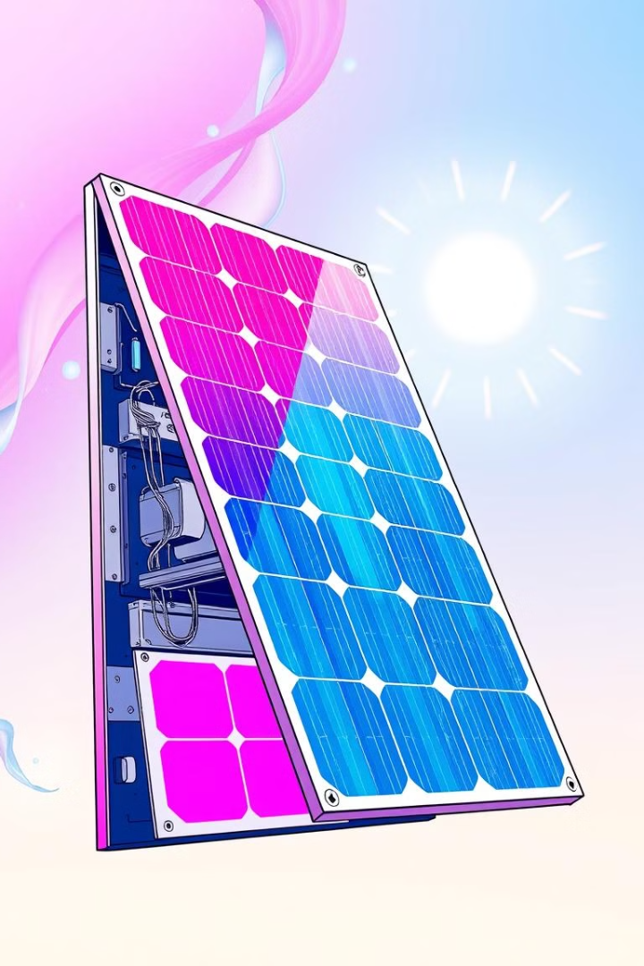

Performance Analysis of Solar Cell using Machine Learning
This presentation explores the use of machine learning for analyzing the performance of solar cells, a critical area of research for optimizing energy efficiency and cost-effectiveness in renewable energy technologies.
by Md Mehedi Hasan Shuvo

Slide 2
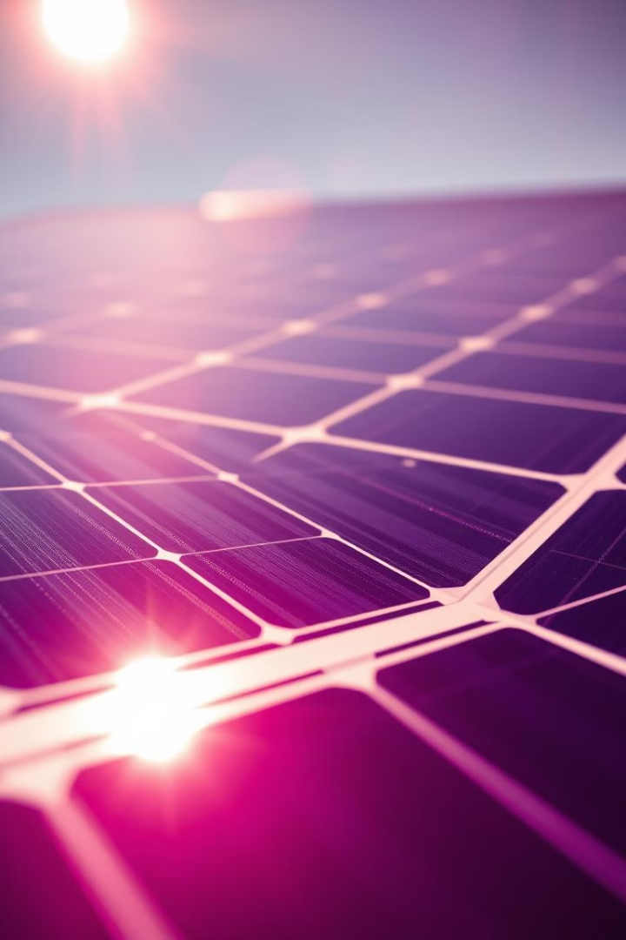
Introduction to Solar Cells and their Importance
1
Photovoltaic Effect
2
Renewable Energy
Solar cells convert sunlight into electricity using the photovoltaic effect, where photons excite electrons in a semiconductor material.
Solar cells play a crucial role in transitioning to renewable energy sources, reducing dependence on fossil fuels.
3
Sustainable Future
The development and optimization of solar cells contribute to a more sustainable and environmentally friendly future.

Slide 3
Challenges in Solar Cell Performance Analysis
Environmental Factors
Cell Degradation
Data Complexity
Factors like temperature, humidity, and irradiance significantly impact solar cell performance.
Solar cells degrade over time due to various factors, such as material fatigue and environmental exposure.
Solar cell performance data is often noisy, irregular, and multi-dimensional, requiring advanced analysis techniques.
Accurate measurement and modeling of these factors are crucial for analysis.
Predicting and mitigating degradation is essential for maintaining optimal performance.
Machine learning provides powerful tools to handle these complexities.

Slide 4
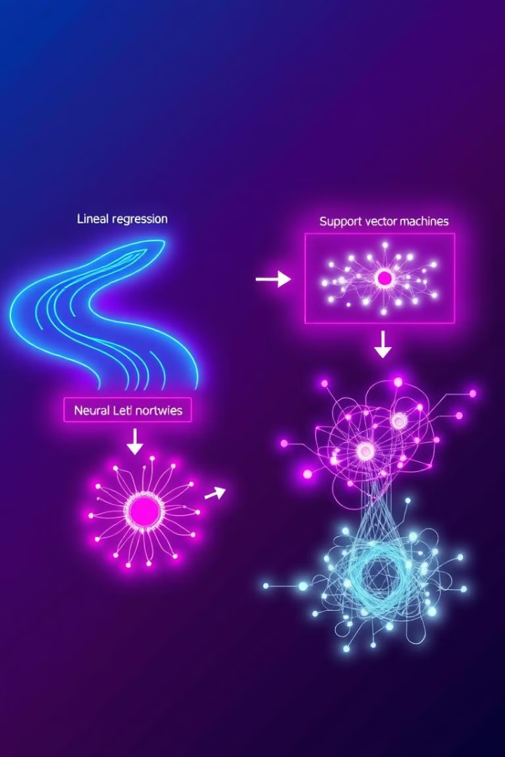
Overview of Machine Learning Techniques
1
Supervised Learning
Predictive modeling based on labeled data, such as regression for estimating solar cell efficiency.
2
Unsupervised Learning
Discovering patterns and relationships in unlabeled data, such as clustering for grouping similar cells.
3
Reinforcement Learning
Training agents to make decisions based on rewards, potentially optimizing solar cell control systems.

Slide 5




Data Collection and Preprocessing
Data Acquisition
Collecting real-time data on various factors, including solar irradiance, temperature, voltage, and current.
Data Cleaning
Removing outliers, handling missing values, and ensuring data consistency for reliable analysis.
Feature Engineering
Transforming raw data into features that can be effectively used by machine learning models.

Slide 6

Python Code for Data Analysis
```python import pandas as pd import numpy as np from sklearn.model_selection import train_test_split from sklearn.linear_regression import LinearRegression # Load data from a CSV file data = pd.read_csv('solar_data.csv') # Select relevant features X = data[['irradiance', 'temperature']] y = data['efficiency'] # Split data into training and testing sets X_train, X_test, y_train, y_test = train_test_split(X, y, test_size=0.2) # Create a linear regression model model = LinearRegression() # Train the model on the training data model.fit(X_train, y_train) # Make predictions on the test data y_pred = model.predict(X_test) ```

Slide 7

Model Training and Evaluation
Metric
Description
Accuracy
Overall percentage of correct predictions.
Precision
Percentage of true positives among predicted positives.
Recall
Percentage of true positives among actual positives.

Slide 8




Model Deployment and Optimization
Cloud Deployment
Model Tuning
Model Updates
Deploying trained models on cloud platforms for scalability and accessibility.
Fine-tuning model hyperparameters to improve performance based on real-world data.
Regularly retraining and updating models with new data to maintain accuracy.

Slide 9
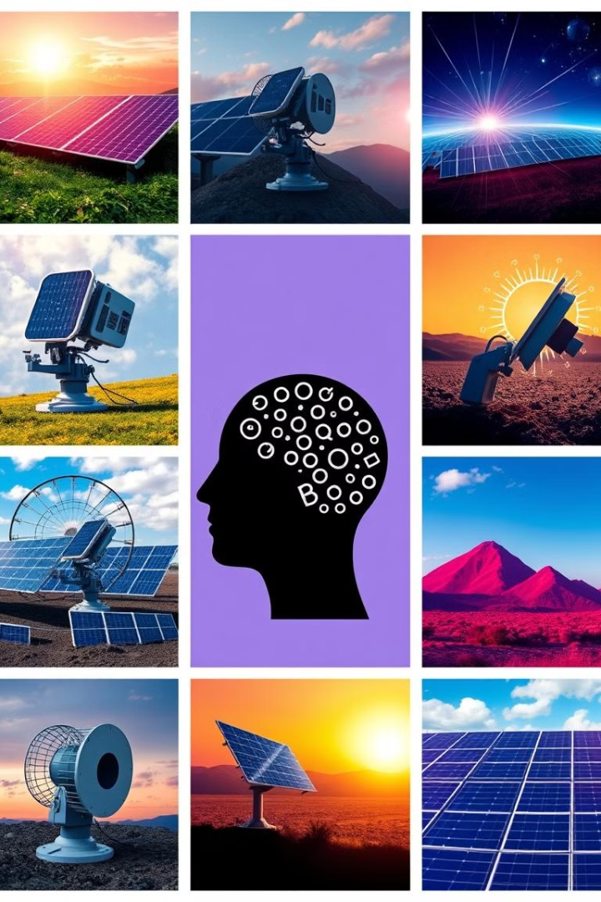
Applications of Machine Learning in Solar Energy
Predictive Maintenance
Solar Tracking
Optimizing solar panel orientation to maximize energy production by tracking the sun's movement.
Forecasting potential failures in solar panels based on historical data, reducing downtime and maintenance costs.
Energy Management
Predicting energy demand and optimizing grid integration of solar energy sources for efficient power distribution.

Slide 10

Conclusion
Machine learning is playing a vital role in advancing solar cell performance analysis and development, contributing to a more sustainable and efficient energy future. As technology continues to evolve, we can expect even greater breakthroughs in this field.

